Slide 1
How easy to create a POP song?
Speaker: Johnny

Slide 2
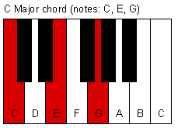
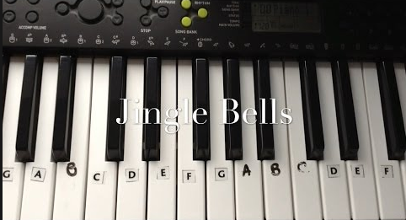
Easy POP Chorus Progression
Basis of chorus
Chorus on piano
Usually F –> G –> Em -> Am in whole song !

Slide 3
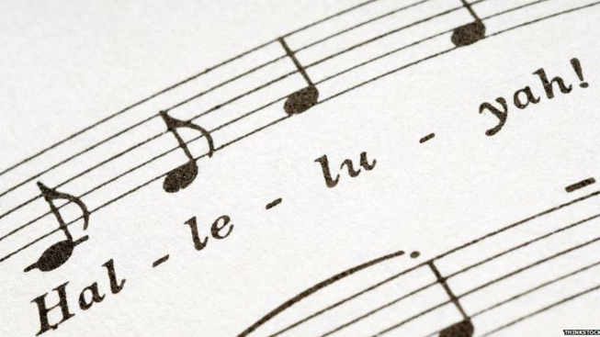
What’s In Your Mood?
Fill the lyrics in the melody!
POP music always talks about something unmeaningful.
Now watch me whip (Kill it!)
Now watch me nae nae (Okay!)
Now watch me whip whip
Watch me nae nae (Want me do it?)

Slide 4

Put Your Instruments Down!
Using a music arrangement software.
Based on how familiar with those Instruments.

Slide 5
Questioning Time!

Slide 6
Thanks for listenening!

